Slide 1
Online Art Gallery
Namrata Gajjar
Babasaheb Ambedkar Open University
Roll No: 1234567890

Slide 2
Features
Login and registration of users
Online exhibition of paintings
Category wise filtering for photography, acrylic and water paintings
Quick access to artist details and his achievements
Contact and subscribe to artist
Purchasing of paintings online by adding to cart and checkout
Social media( Facebook, Twitter, Instagram) connection
Management of information by admin account

Slide 3
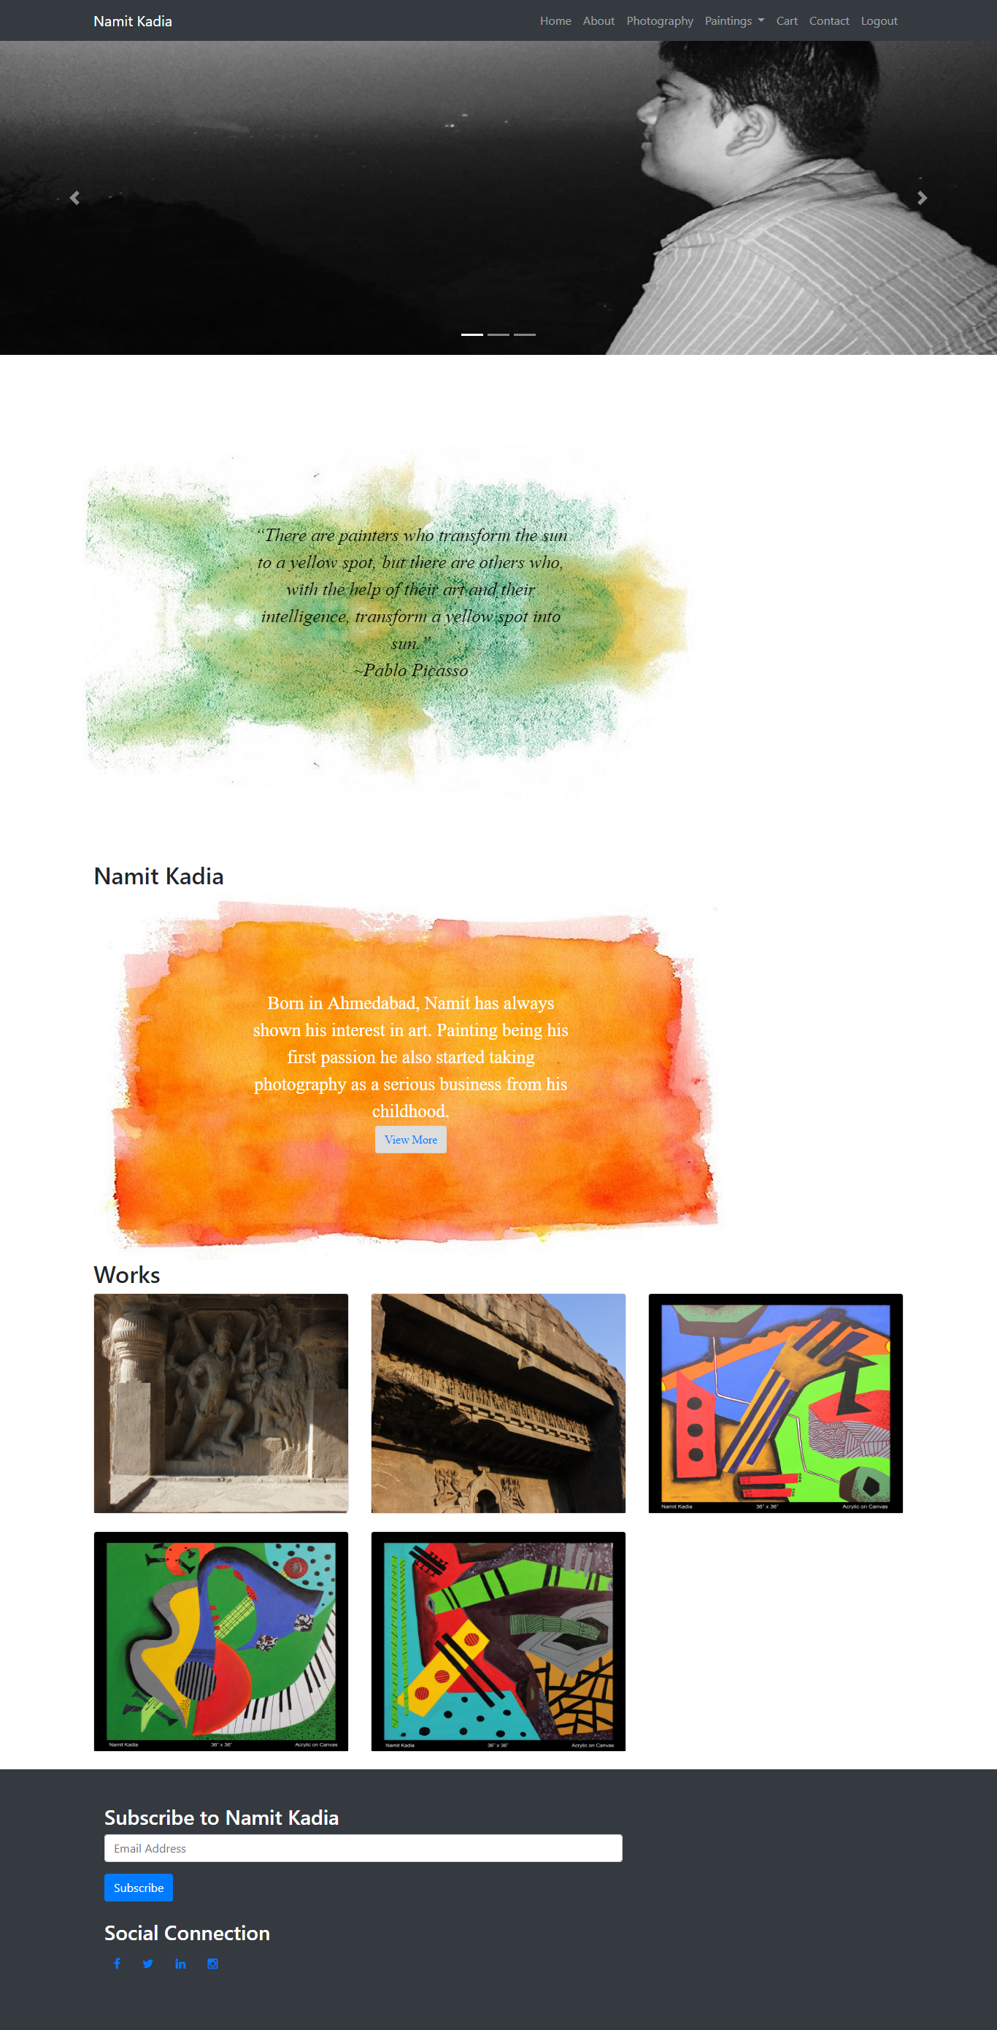
Art Gallery - Home

Slide 4
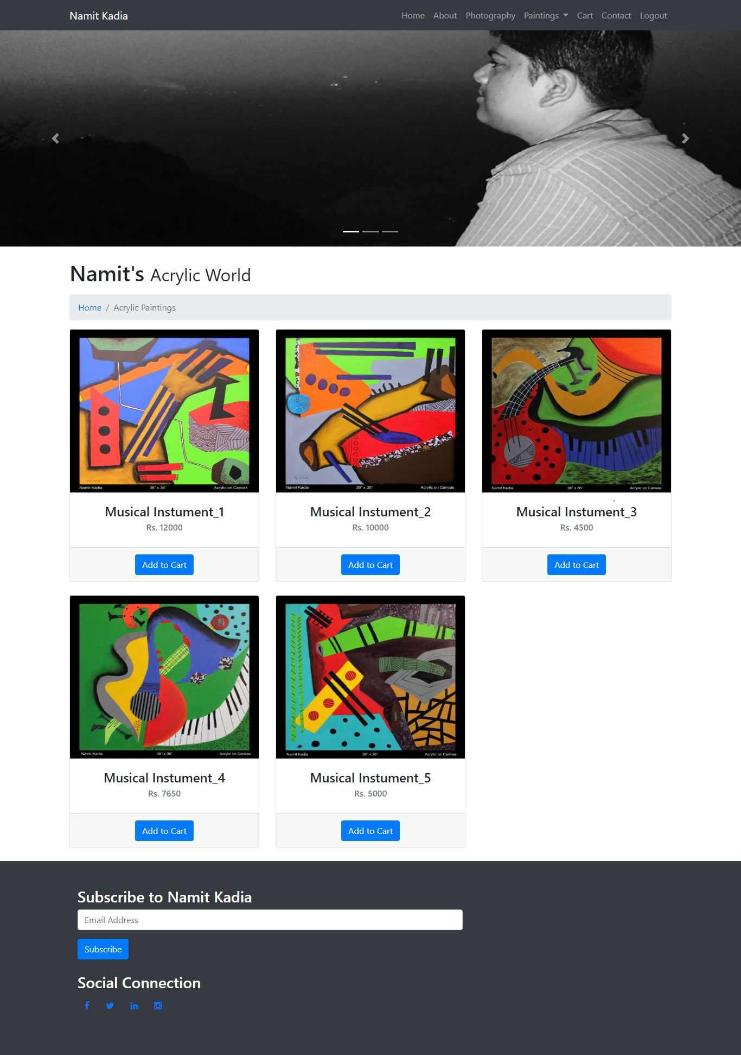
Art Gallery - Category

Slide 5
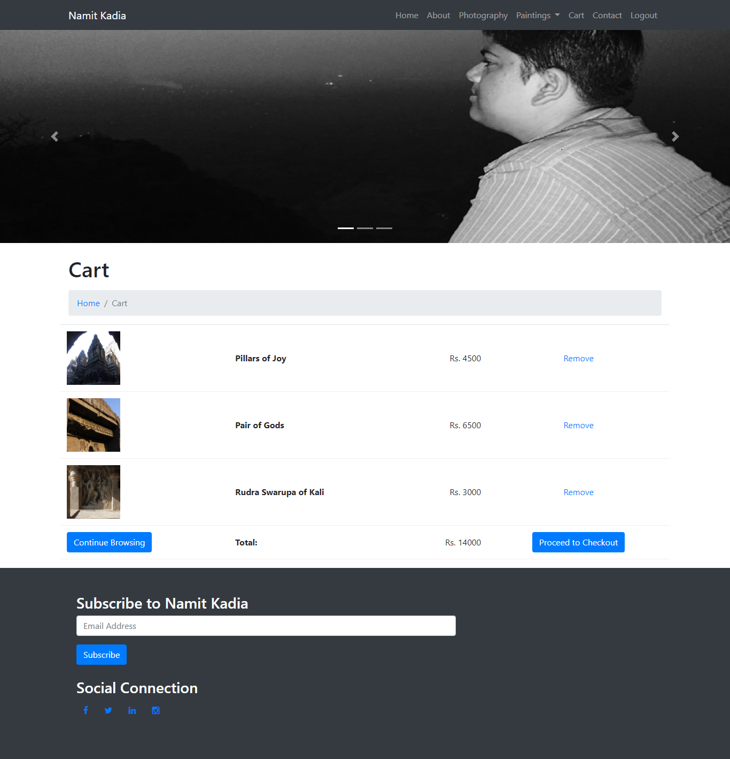
Art Gallery - Cart

Slide 6
Technologies
PHP – For server side programming
Apache - Server
MySQL – For database management
HTML – For presentation of web pages
CSS – For styling of web pages
XAMPP ( Software for PHP, Apache and MySQL)

Slide 7
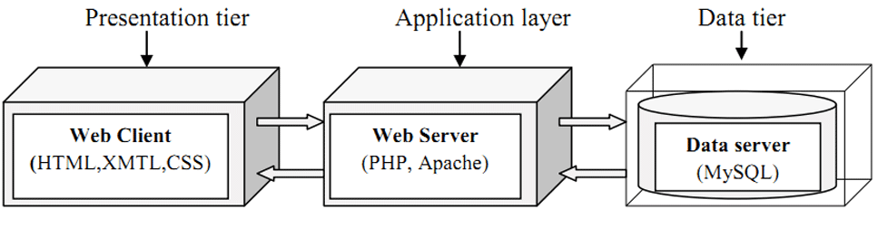
Architecture

Slide 8
Thank You

